Slide 1
Resource Allocation / Best Practice

Slide 2

Discussion points
Can I use the entire cluster at once?
Where should I write data to?
Which queue/partition should I use?
How much CPU/memory should I allocate to a job?
“It depends”
https://help.cropdiversity.ac.uk/slurm-policy.html

Slide 3
Can I use the entire cluster at once?
It depends…
the question is really: should I use the entire cluster at once?
While there are currently no limits to prevent you from submitting a job that uses every CPU across one or more queues, you first need to ask yourself how sensible that would be? Consider:
how long the job will last?
how busy is the cluster?
how much you value your friendship with other cluster users?
currently trialling a 256 core per queue limit
Notes:
Short running tasks allow others’ jobs to rise in priority above yours (the fair-share policy), so submitting a 10,000 jobs that only last a few minutes each will ‘hog’ the cluster much less than just a few tens or hundreds of jobs that last for hours and hours. If it’s 2am and no-one else is using the cluster, then it’s less likely to be detrimental to anyone else. This is a shared resource, and while it’s here to be used, it’s not here to be abused.

Slide 4

Where should I write data to?
Where you decide to store data will influence performance, available capacity, and backup policies, so it’s important that you understand the differences between the storage locations and the folders they contain
home folders
/home
project folders
/mnt/shared/projects
scratch space
/mnt/shared/scratch

Slide 5
Where should I write data to?
Data can be both shared (visible to all nodes) and local (visible to each specific node only)
home folders
/home
project folders
/mnt/shared/projects
scratch space
/mnt/shared/scratch
node scratch space
$TMPDIR
shared BeeGFS storage (1.5 PB)
local SSDs (1-2 TB max)

Slide 6


Backups
Backup policies differ across the tiers:
home folders
30 dailies
project folders
30 dailies and 18 monthlies
scratch space
node scratch space
not backed up

Slide 7
What to store where
Project folders:
store: data from “official” projects -- raw data, scripts, results that need to be kept long term
what NOT to store: bulky, intermediate files that can be recreated (e.g. BAM files), “debris” created by messy software packages (e.g. thousands of small files from a Trinity assembly)
Scratch:
store: data analysis outputs in progress
what NOT to store: anything that requires permanent storage should be moved to the projects folder if/when you’re sure that you need to keep it
Home folders:
store: as little as possible (<10GB)
what NOT to store: “official” project data, big files

Slide 8

Storage performance
Our BeeGFS filesystem maximum file transfer rate is around 12 GB/s
it’s great for parallel transfers of large data to multiple jobs at once
but it doesn’t like working with lots and lots of very small files
Local node scratch uses SSDs
while it can’t match the large streaming transfer rates of the BeeGFS system, it will always win when reading/writing lots of very small files
but it’s limited in size
and only exists for the lifetime of each job

Slide 9
Where to process data
Is it faster to:
a) read and write everything in shared scratch?
b) read from shared scratch and write to local scratch?
c) copy everything to local scratch and work from there?
Either way, b and c also require results to be copied back to shared scratch before the job ends
But if you’re doing a lot of random I/O (or a lot of small file I/O) then chances are things will be much faster with local scratch

Slide 10

The Linux kernel
Release 5.19.2 (2022-08-17)
just 126MB compressed
but almost 82,000 files and folders
https://cdn.kernel.org/pub/linux/kernel/v5.x/linux-5.19.2.tar.xz

Slide 11
Activity: unzip the kernel source
#!/bin/bash
#SBATCH --partition=debug
cd ~/scratch/training/data
time tar -xf kernel.tar.xz
GROUP 1 (network)
#!/bin/bash
#SBATCH --partition=debug
cd $TMPDIR
cp ~/scratch/training/data/kernel.tar.xz .
time tar -xf kernel.tar.xz
cp linux-5.19.2/README ~/scratch/training/
GROUP 2 (local scratch)

Slide 12
Monitoring network I/O
You can keep an eye on your network (/mnt/shared/) input/output via:
You’ll probably need to maximize your screen
Prints (every 5s) a summary of each user’s current file I/O
$ beegfs-ctl --userstats --nodetype=storage --names
exclude to see metadata performance only

Slide 13
Transparent file compression
All data on our shared spaces is transparently compressed
$ ls –lh raspberry.fasta
-rw-r--r-- 1 username username 289M Mar 10 13:00 raspberry.fasta
$ du –h raspberry.fasta
181M raspberry.fasta
$ du -h --apparent-size raspberry.fasta
289M raspberry.fasta
$ ls -lh raspberry.fasta.gz
-rw-r--r-- 1 username username 84M Mar 10 13:00 raspberry.fasta.gz
actual size
compressed size
actual size
even smaller

Slide 14
Which queue/partition should I use?
It depends….
Time limits:
Short queue – 6 hours
Medium – 24 hours
Long – 14 days
Historical observation and anecdotal evidence:
a significant number of jobs seem to complete OK within 24 hours (so use medium)
but the bigger your job or data sets that you want to process, the more likely it is to overrun and therefore be safer on the long queue
however, if the long queue is busy, you may then have to wait longer for your job to start
Note though, that each task of an array job has its own time allocation, so you could still successfully run a week-long job on the medium queue if each of its subtasks completes in less than 24 hours.
If it’s an interactive job, then you’re probably better off running it on the short queue.
gpu/himem queues are special cases
these resources are scarce, so be very considerate in your use of them, especially for long running jobs

Slide 15
How much CPU/memory should I allocate to a job?
Allocating CPUs or memory is easy
Allocating the correct amount of CPU or memory is more challenging
too few CPUs, your job may run slower
too many CPUs, could see idle CPUs because it’s not optimized – you’re then wasting resource and blocking others
not enough memory, your job will fail
too much memory, you’re wasting resource and blocking others
Each program and/or data set will be different; experimentation is really the only way to know for sure
memory: start with little, ramp it up until your job doesn’t run out of memory any more
for array jobs: start by running a single job only until you have optimised the memory consumption:

Slide 16
Monitoring jobs
https://cropdiversity.ac.uk/top

Slide 17
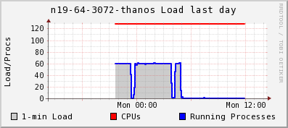
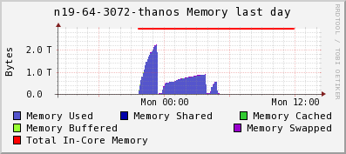
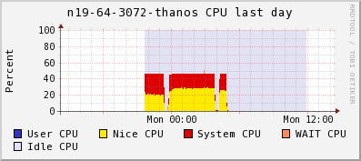
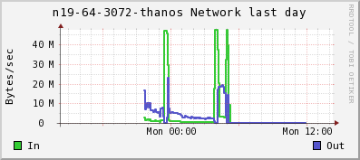
Monitoring jobs
https://ganglia.cropdiversity.ac.uk

Slide 18
Allocating memory
Default memory allocation per job task is 1.5GB
If you need more, you have to ask for it:
--mem=32G
If your job uses more than the allocation:
it may fail because it can’t get enough memory
it may be killed because it used too much
A significant number of jobs request too much…

Slide 19
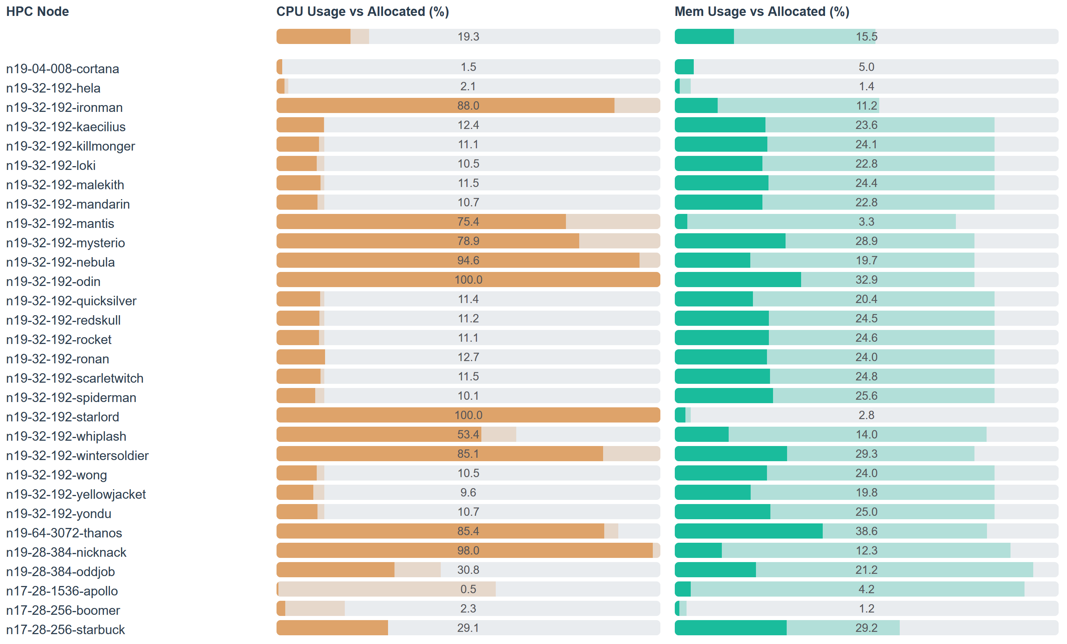
Allocating memory

Slide 20

Green computing
Lowers the carbon footprint of computing via environmentally responsible and/or eco-friendly use of computers
Idle nodes will power down when not in use
saves energy by lowering the electrical demand of the cluster
reduces load on its cooling systems, saving yet more energy
By intelligently monitoring job submissions, nodes can be automatically powered up again as and when they are needed.

Slide 21
Green computing
1 job is approx. 120 watts
64 jobs is approx. 330 watts
6 jobs is approx. 720 watts

Slide 22
How much memory is my job using?
top/htop provide live info
Slurm can provide limited information on a running job
Start something running, then try:
sjobstat is an alias for:
$ sjobstat –j jobid
JobID MaxRSS
------------ ----------
537245.batch 85230296K
maximum memory usage (so far)
$ sstat --format=JobId,MaxRSS

Slide 23
How much memory did my job use?
Slurm’s historical (post-job) information is much better:
sjobacct is an alias for:
$ sjobacct -j jobid
JobID ReqMem MaxRSS AllocCPUS TotalCPU State Elapsed
------------ ---------- ---------- ---------- ---------- ---------- ----------
497778_2192 6Gn 2 37:33.406 COMPLETED 00:38:08
497778_2192+ 6Gn 2.78G 2 37:33.405 COMPLETED 00:38:08
497778_2192+ 6Gn 0.00G 2 00:00.001 COMPLETED 00:38:08
requested mem
max mem usage
cpu time
wallclock time
$ sacct --format=JobId,ReqMem,MaxRSS,AllocCPUS,TotalCPU,State,Elapsed --units=G

Slide 24
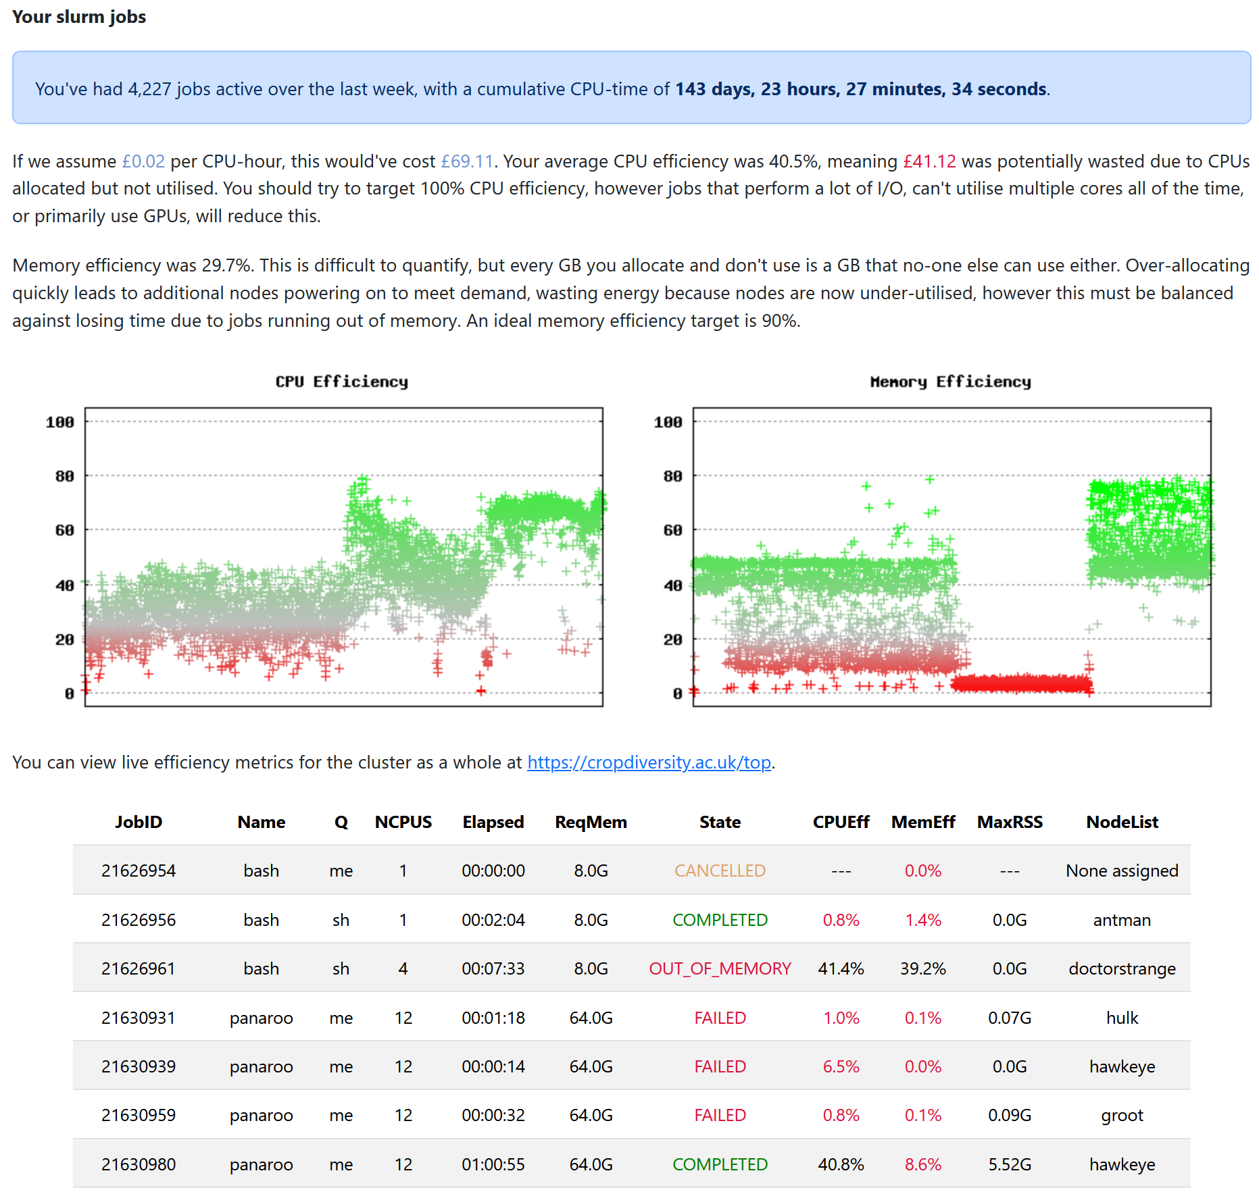

Slide 25
Activity: array jobs (setting limits)
You can limit the number of jobs running in parallel, eg:
--array=1-1000%50
(limits a 1000 task array to a max of 50 simultaneously running tasks)
#!/bin/bash
#SBATCH --partition=debug
#SBATCH --cpus-per-task=4
#SBATCH --array=0-9%5
FILES=(*.fasta)
pigz -k -f ${FILES[$SLURM_ARRAY_TASK_ID]}

Slide 26
Post job emails
Slurm will automatically provide these summaries if you enable post-job emails:
It’s CRITICALLY important that you regularly review your usage and adjust job allocations accordingly
#!/bin/bash
#SBATCH --mail-user=email@address.com
#SBATCH --mail-type=END,FAIL
Notes:
If running a large array job, submit it first with a few samples and then adjust your allocations as needed

Slide 27
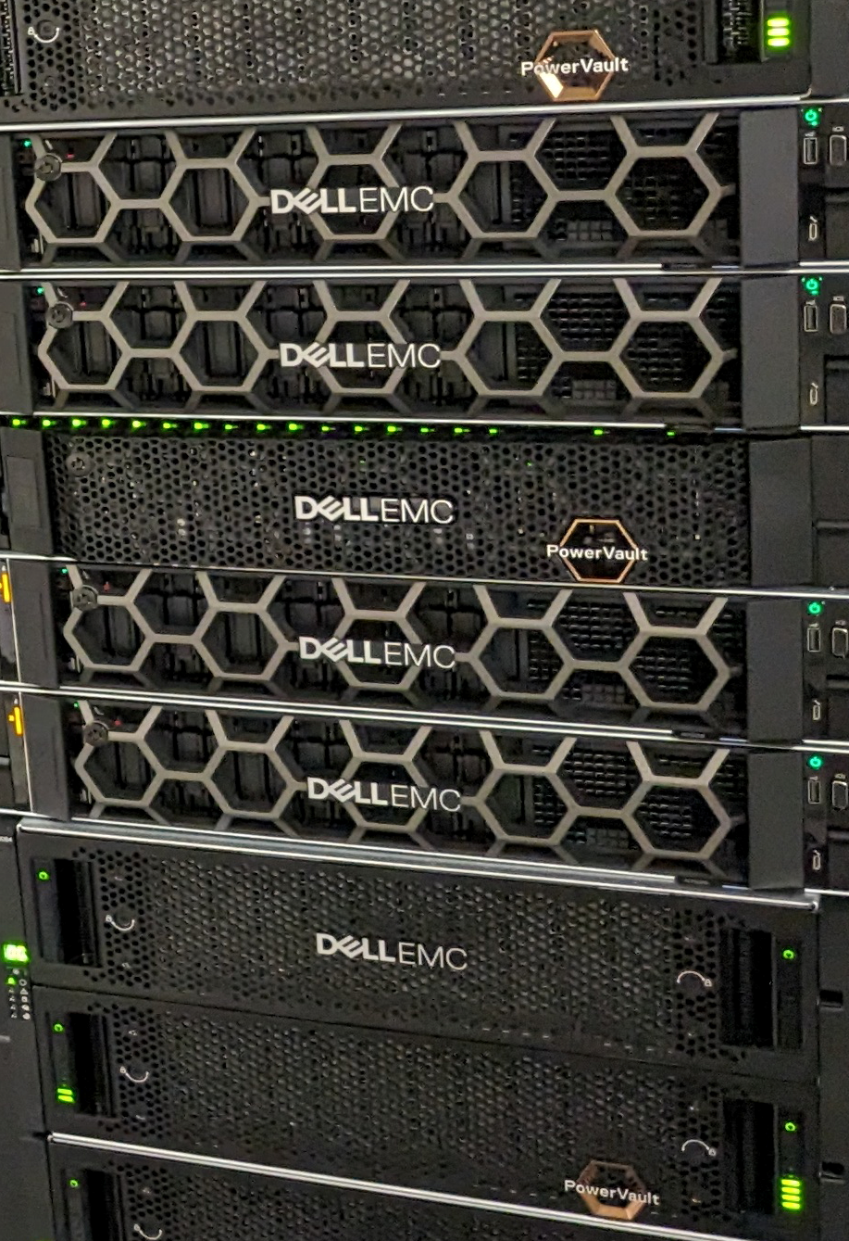
In summary
Using the cluster efficiently is in everyone’s best interests
Experimentation is (unfortunately) still the best way to know how much CPU/Memory to allocate
but performance is also affected by storage choice
Lots of good ways of monitoring your jobs – so use them and adapt
And lastly, don’t forget Slack. We’re a community and people are always willing to help

